Slide 1

SMART INDIA HACKATHON 2026
TITLE PAGE
Problem Statement ID – SIH 1753
Problem Statement Title- RTN Dynamic Capacity & Route Optimization System (DoP)
Theme- Transportation & Logistics
PS Category- Software
Team ID-139
Team Name- SochX

Slide 2
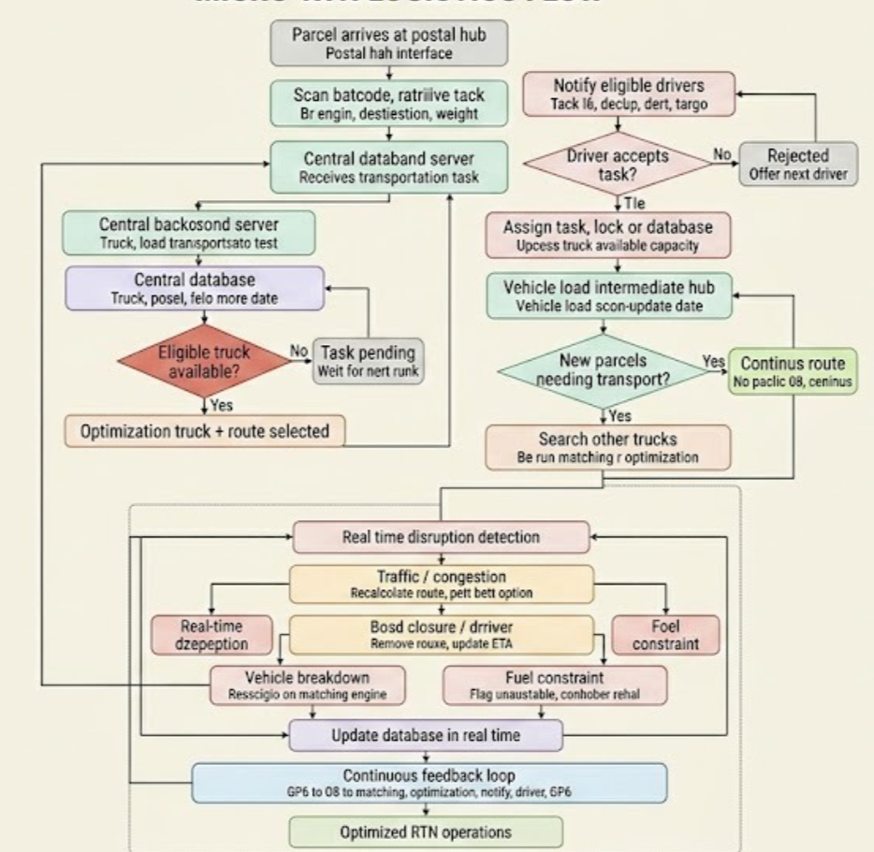
RTN DYNAMIC CAPACITY & ROUTE OPTIMIZATION SYSTEM
SochX
Proposed Solution: Real-time dynamic truck-capacity & route optimization for India Post's RTN
Barcode scan auto-creates a task; a Matching Engine finds eligible trucks and an OR-Tools Optimization Engine picks the best feasible truck + route
Replaces static truck assignment; re-checks capacity at every intermediate hub and adds compatible parcels to trucks already in transit
Dynamic mid-route capacity allocation, live disruption handling (traffic, breakdowns, fuel), and a continuous real-time feedback loop

Slide 3
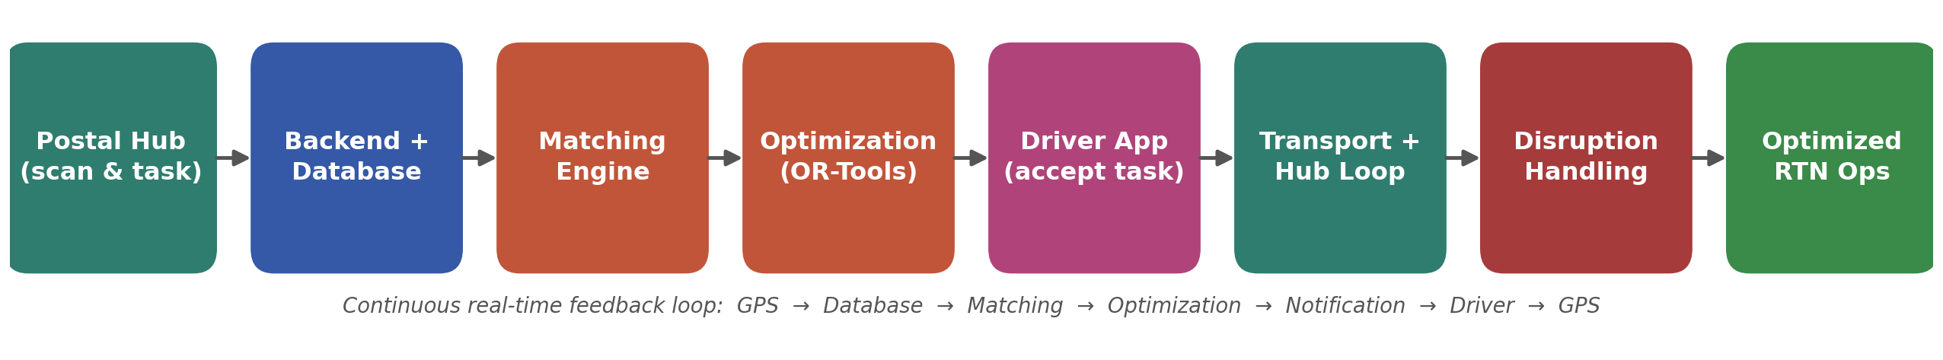
TECHNICAL APPROACH
SochX
Backend + central database, Driver Mobile App (GPS), Postal Hub barcode scanning, Matching Engine, Google OR-Tools Optimization Engine, real-time Notification System
Task created → matched to a truck → optimized route → driver accepts → capacity reallocated at each hub → disruptions trigger live re-optimization (see flow diagram below)

Slide 4
FEASIBILITY AND VIABILITY
SochX
Feasibility: Builds on infrastructure India Post already has (hubs, fleet, barcoded parcels); OR-Tools is open-source and proven for vehicle routing at scale
Challenges: Patchy rural connectivity, driver app adoption, and keeping truck/parcel data accurate for real-time matching
Strategies: offline-first driver app, phased hub-by-hub rollout on high-volume routes first, and simple driver training

Slide 5
IMPACT AND BENEFITS
SochX
More predictable delivery across India Post's road network, especially rural and semi-urban routes served today by fixed, underused truck schedules
Economic: lower cost, fewer empty trucks.
Social: Increase of efficiency and security during delivery.
Environmental: fewer and optimized trips, less fuel & emissions
Maximum capacity utilized of every truck.
Gradual but drastic increase of employment and revenue.
Increased transparency between consumers and services.

Slide 6
RESEARCH AND REFERENCES
SochX
Google OR-Tools Vehicle Routing docs (developers.google.com/optimization/routing); India Post Annual Report (indiapost.gov.in); literature on the Dynamic Vehicle Routing Problem (DVRP)
LLM’s (ChatGPT, Gemini, Claude, etc)

Slide 7
IMPORTANT INSTRUCTIONS
Please ensure below pointers are met while submitting the Idea PPT:
Kindly keep the maximum slides limit up to six (6). ( Including the title slide)
Try to avoid paragraphs and post your idea in points /diagrams / Infographics /pictures
Keep your explanation precise and easy to understand
Idea should be unique and novel.
You can only use provided template for making the PPT without changing the idea details pointers (mentioned in previous slides).
You need to save the file in PDF and upload the same on portal. No PPT, Word Doc or any other format will be supported.
Note - You can delete this slide (Important Pointers) when you upload the details of your idea on SIH portal.

